Slide 1
RA 505 Robot Sensing and Vision Lecture 31
Dr. Rishikesh Kulkarni
Department of Electronics and Electrical Engineering
IIT Guwahati

Slide 2
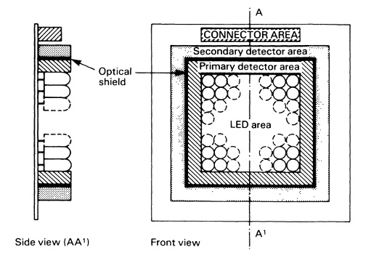
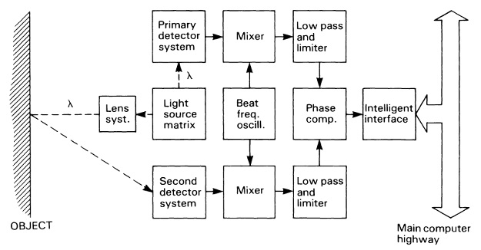
LED array range-finder
No moving parts
Cheap light sources
Lower optical launch power and lower x-y resolution
suitable for eye-in-hand robot vision applications
Electronic multiplexing of LED driver
Principle
Obstacle avoidance and pick-and-place operations

Slide 3
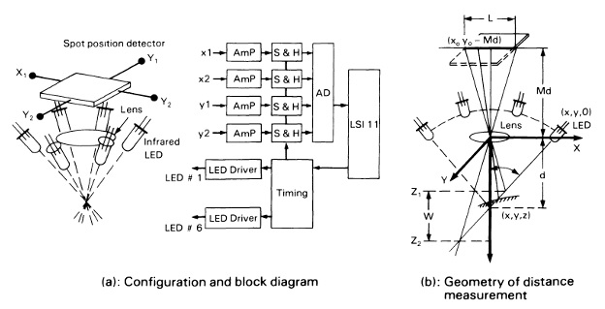
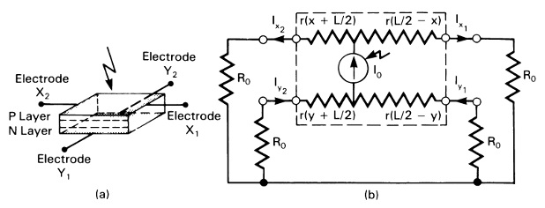
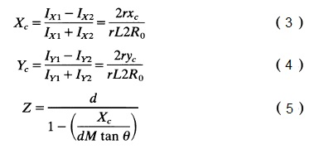
LED array range-finder
Circular LED-array
Simplicity of the operating principle
Fast speed (~ 1000 range measurements per second)
Precision (0.07 mm)
Large size
Smaller range of operation (~ 4-5 cm)

Slide 4
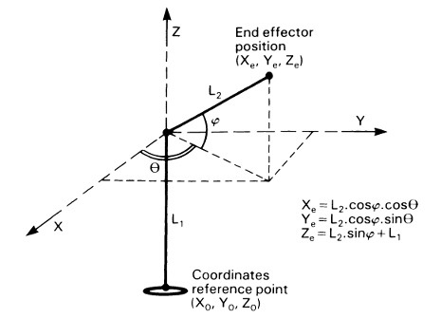
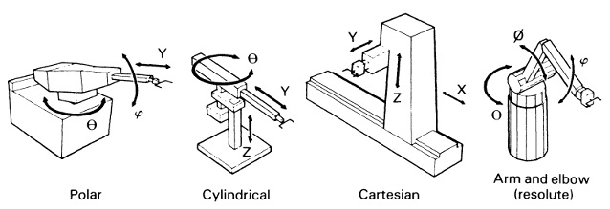
Position sensors
In robot structure, position of each joint is required to calculate the position of the end effector
Enables successful completion of programmed task
robot coordinate systems
Internal position transducers (proprioceptors)

Slide 5
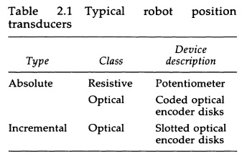
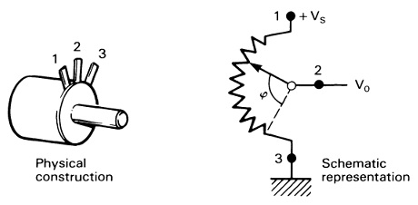
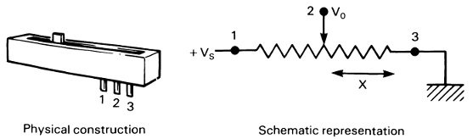
Position sensors

Slide 6
Position measurement
Resistive potentiometers
Resistive element with movable contact
contact motion can be translation, rotation or combination of the two
The resistive element is excited with either AC or DC voltage
resistive elements come with different types such as wire-wound, conductive plastic, deposited film or cermet (ceramic + metal)

Slide 7
Position measurement
Resistive potentiometers
Trade-off between linearity and sensitivity
Resolution Vs Range: continuous strip of resistive element/ wire-wound
Low cost, small size
Educational and light industrial robots

Slide 8
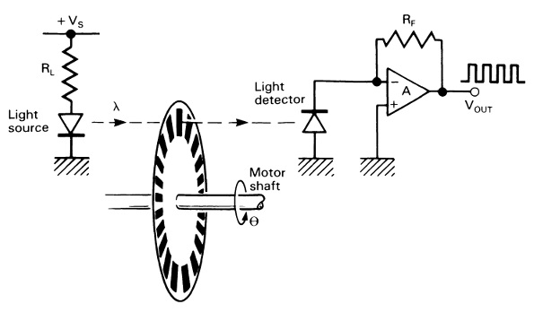
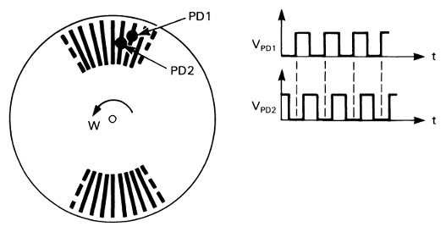
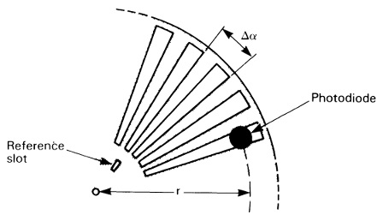
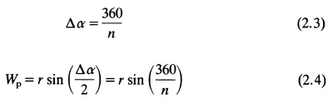
Incremental optical encoder

Slide 9
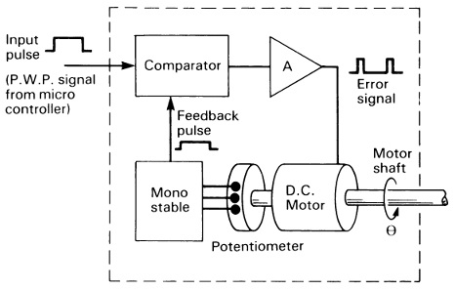
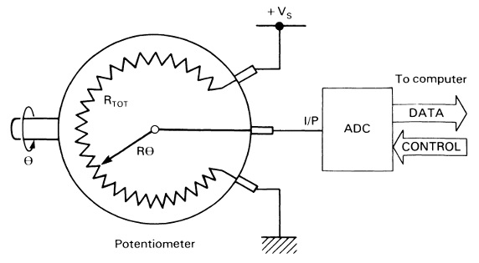
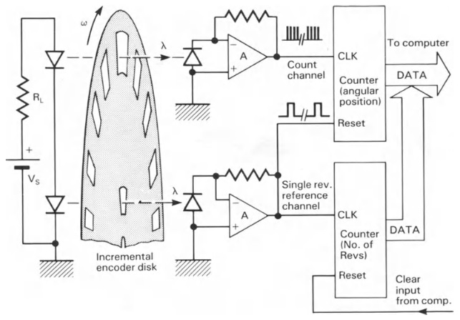
Position sensor interfacing

Slide 10
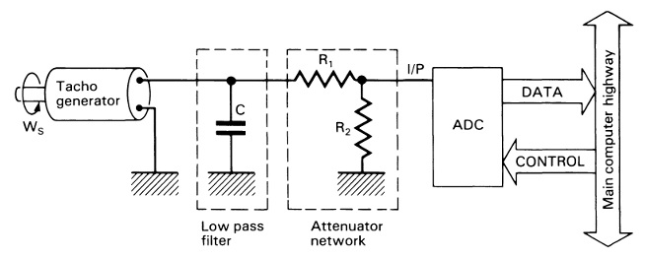
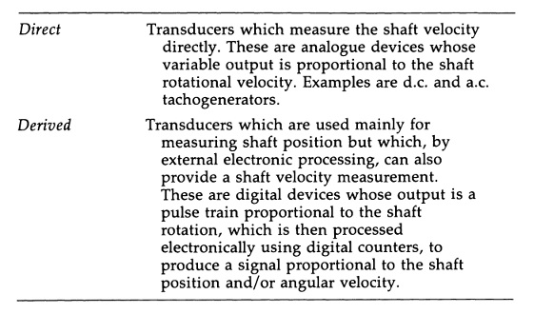
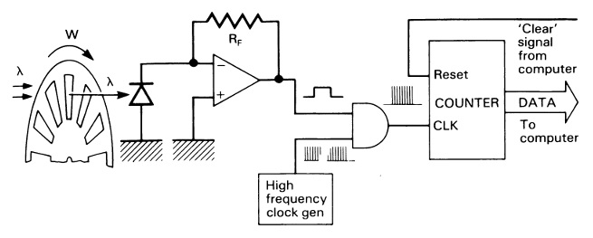
Velocity sensors

